Slide 1

Improving Delivery Performance and Customer Satisfaction: Managing Late Delivery Risks
Explore advanced analytics to curb late deliveries and boost customer trust.
Presented by Turgud Valiyev (466760)
Data Consulting Class Project
GitHub Repository

Slide 2

What is Late Delivery?
Definition
Delivery arriving after the scheduled or promised date.
Example Scenarios
Shipment dispatch delays
Last-mile delivery challenges
Inventory and logistics issues

Slide 3

Business Impact of Late Deliveries
Customer Dissatisfaction
Delays reduce customer trust and loyalty.
Negative Reviews & Churn
Unhappy customers share poor experiences.
Revenue Loss
Missed sales and operational inefficiencies.
Increased Customer Service Costs
More resources spent handling complaints.

Slide 4

Project Objective
Identify Delivery Patterns
Recognize trends causing late deliveries.
Analyze Geographic & Product Trends
Spot risk factors by location and category.
Model Risk Prediction
Flag risky deliveries before delays occur.
Recommend Improvements
Suggest actionable steps to reduce risks.

Slide 5
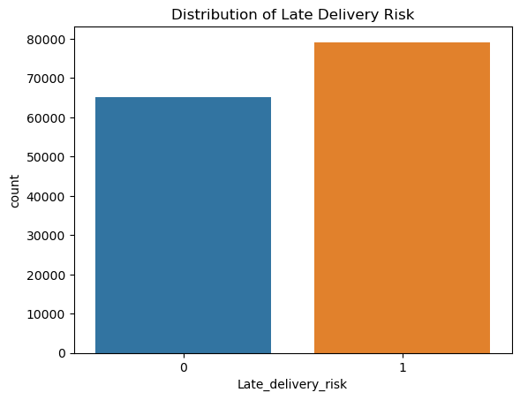
Key Insights – Delivery Risk Distribution
Approximately 55% of deliveries face risk of delay.
Delivery delays are a widespread and persistent challenge.

Slide 6
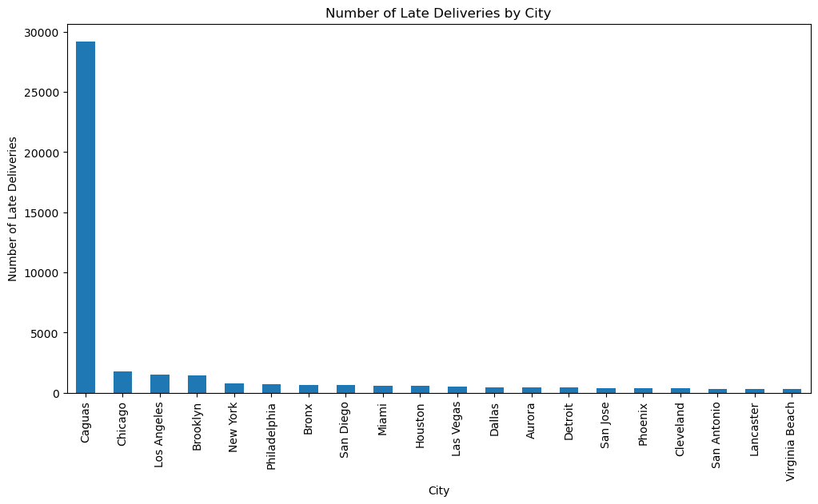
Key Insights – Top Risk Cities
Caugas shows higher delivery risk than others.
In general, big cities are more likely to face delivery risks.

Slide 7
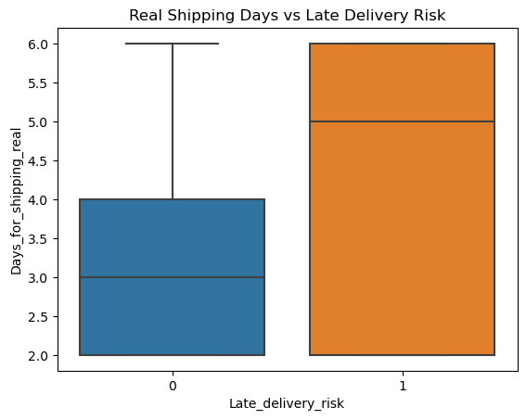
Patterns in Delivery Timeliness
The chart shows that late deliveries (risk = 1) have a median shipping time of 5 days.
In comparison, on-time deliveries (risk = 0) have a median shipping time of 3 days.
It highlights a 2-day delay gap strongly associated with delivery risk.

Slide 8
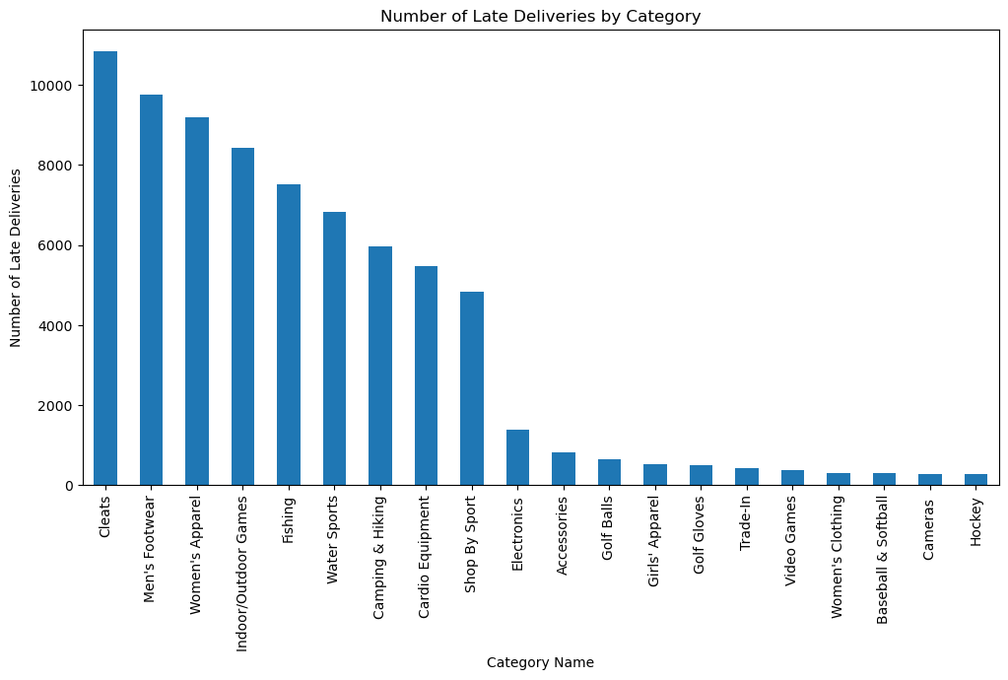
Key Insights – Product Categories at Risk
The chart reveals that Cleats, Men’s Footwear, and Women’s Apparel account for the highest number of late deliveries—each exceeding 9,000 cases—indicating that specific product categories may have persistent fulfillment or supply chain issues requiring targeted interventions.

Slide 9
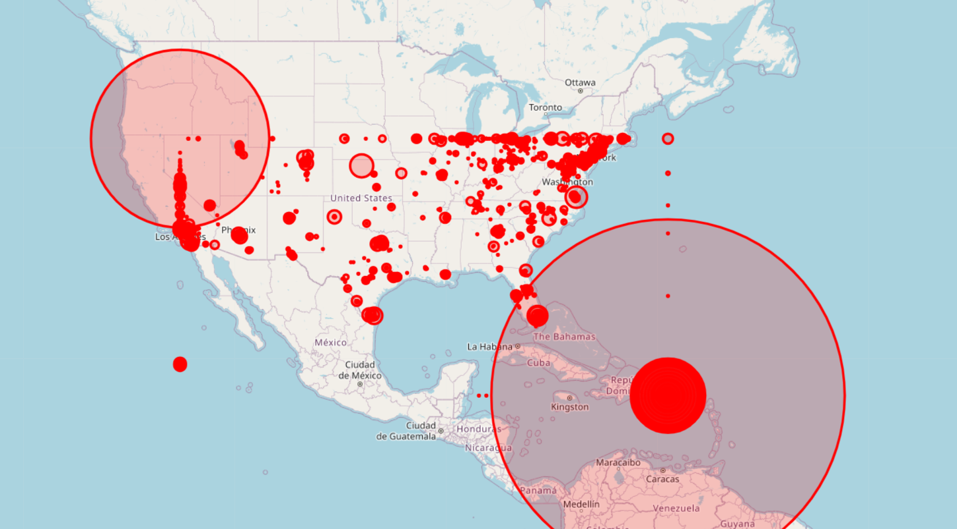
Geographic Risk Hotspots
The geographic heatmap highlights significant late delivery concentrations in Puerto Rico, the West Coast (especially California), and parts of the Northeastern U.S., indicating regional supply chain inefficiencies that require targeted logistical improvements.

Slide 10
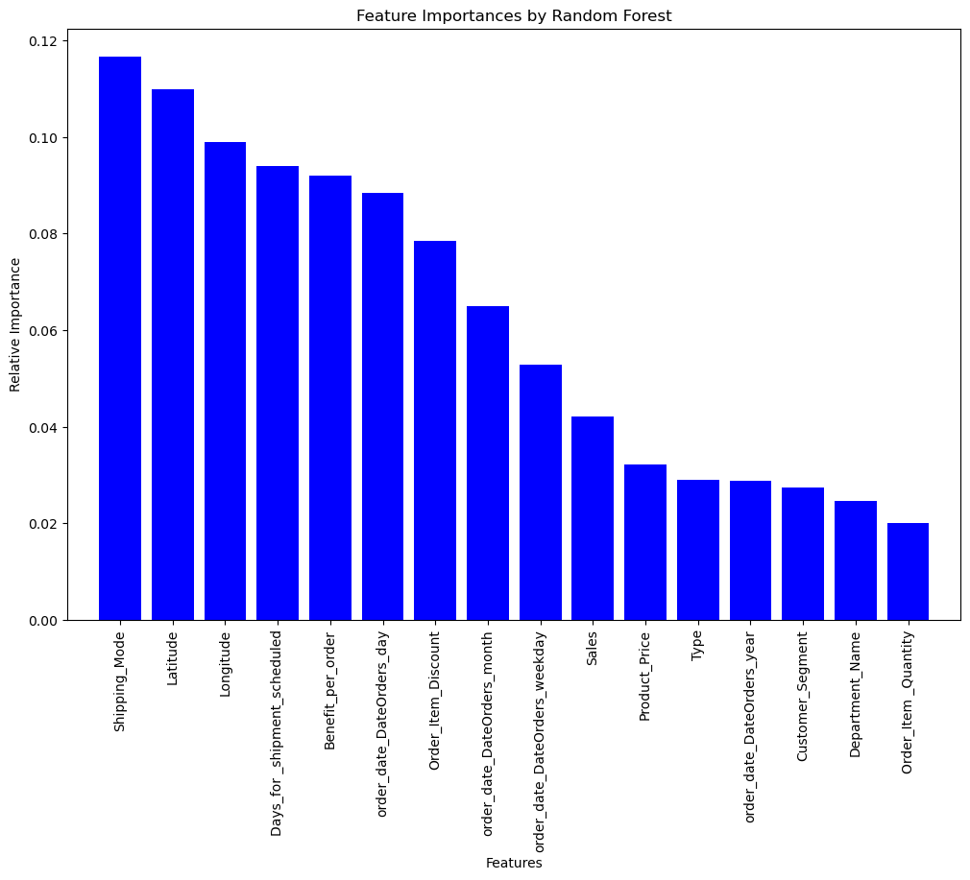
Key Drivers of Late Delivery Prediction
The Random Forest model identifies Shipping Mode, Latitude, and Longitude as the top predictors of late delivery risk, highlighting that logistics and geographic location play a more critical role in delays than customer or product-related attributes.

Slide 11

Forecasting Model for Late Delivery Risk
Model Performance
The Random Forest model achieved a 75% balanced accuracy on unseen (validation) data, making it the most effective predictor of late delivery risk.
Modeling Insight
Non-linear machine learning models (e.g., Random Forest, LightGBM, XGBoost) consistently outperformed linear models, confirming the complexity of delivery delay patterns.

Slide 12
Conclusion
Over 55% of deliveries were at risk of delay, with Caguas and specific product categories showing the highest risks.
Products most affected include Cleats, Men’s Footwear, and Women’s Apparel.
Delays are strongly linked to shipping duration, mode, and geographic location.
These insights highlight key logistics and operational inefficiencies.
The Random Forest model, with 75% accuracy on unseen data, proves effective for forecasting late deliveries.
Combining EDA and predictive modeling offers a powerful tool to reduce risks, boost efficiency, and increase profits.

Slide 13
THANK YOU FOR YOUR ATTENTION !!!

